Slide 1
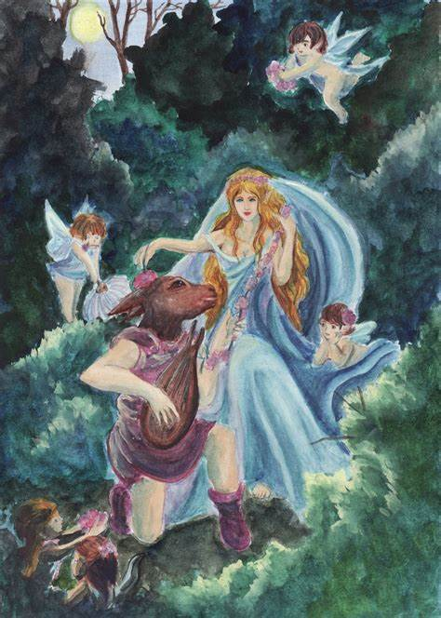
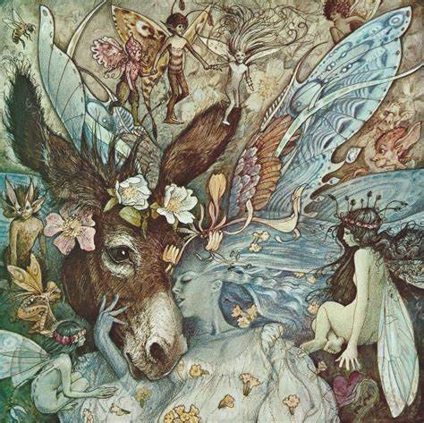
Title: Mastery Task Learning Objective: To analyse an unseen extract in an exam-style format Date: Friday 8th May 2020
Do now:
Which part of the play presents the most disorder / chaos? A) Lover’s Quarrel B) Titania’s love for Bottom C) Robin’s prank
How does Shakespeare maintain the comedic aspect during the chaos? A) Oberon’s reassuring monologue B) Lack of empathy for characters
Who restores the order in the play? A)Oberon B) Robin Goodfellow C) Nick Bottom
Aspire!
Use the word of the week: deride, in a sentence about ‘A Midsummer Night’s Dream’.

Slide 2
Exam-style question
Remember to read the question before you read the extract!
Aim for 3 SEIZE paragraphs
Use the A0 boxes to help you gain as many marks as possible!
A01
Are you using a topic sentence to refer back to the question?
What is happening at this point in the play?
What is atmosphere has Shakespeare created?
A02
What does the quote suggest rather than explicitly tell us?
What techniques does Shakespeare use here?
What effect do the techniques have?
What other ideas could the quote highlight?
A03
How would the Elizabethan audience feel about the issues presented?
What was happening in 16th century that influenced WS?
Does the quote link to any themes – if so, why?

Slide 3
You have 45 minutes to write your answer
Glossary
Knaveries – a mischievous act
Anointed – smeared / rubbed
Welkin – sky or heaven
Anon – soon / shortly
Virtuous – good / moral
Charmed – ability to attract or influence someone
Aurora’s harbinger – the first morning star before dawn

